Slide 1
Project Architecture Team: Gamer
By Henry Bojanowski, Qian Zhang, Opara,Chukwuemeka,Emmanuel, YuHang He,JinHyun Park

Slide 2
Description
Our project is a calculator, but the user needs to answer simple math questions before he/she can access it
The will be four questions in total, all are sum or difference questions
The program decides how many buttons are disabled based on the user’s score. If the user gets two questions wrong, then two buttons will be disabled, 3 means three disabled, 4 means all are disabled

Slide 3
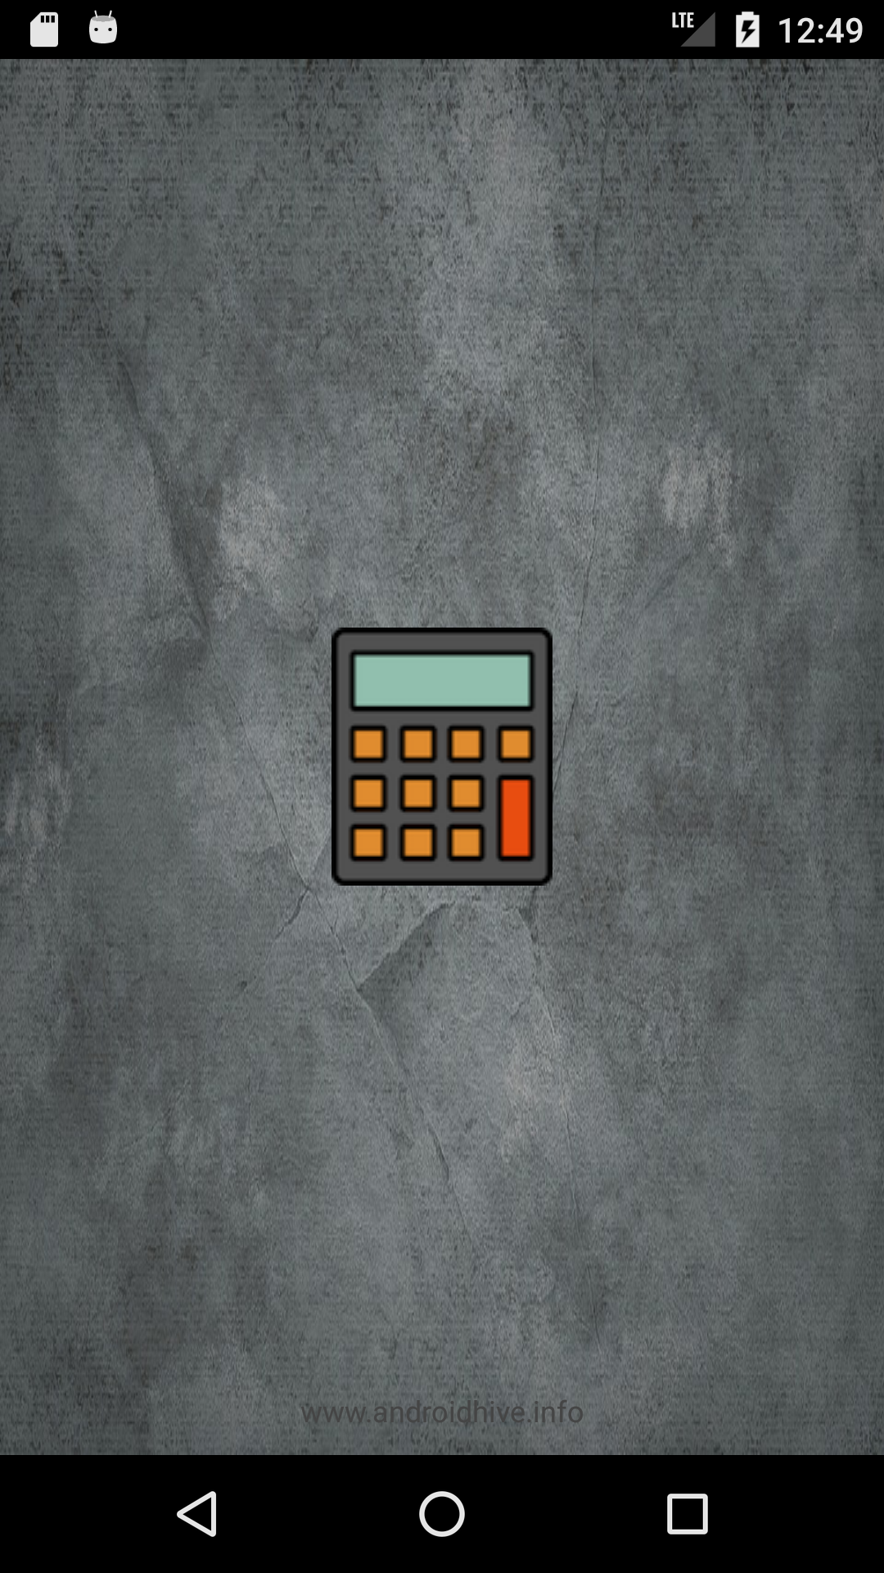
The load page

Slide 4
After the load page, the home page, with a introduction, is displayed, and the user needs to click “Begin” to start

Slide 5
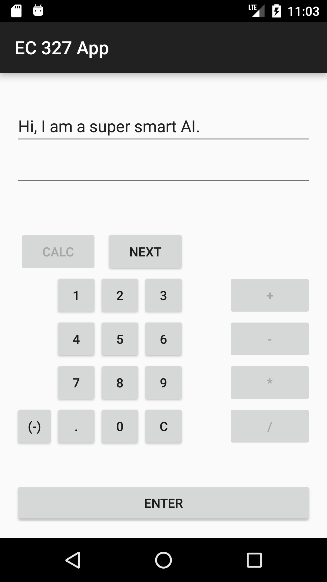
After the user clicks “begin”, the app will show the calculator page. There are three parts on the calculator page.
where the text is displayed.
the keyboard of calculator, but only numbers are accessible.
a button to enter the answer, typed by the user
The user needs to click “Next” to continue

Slide 6
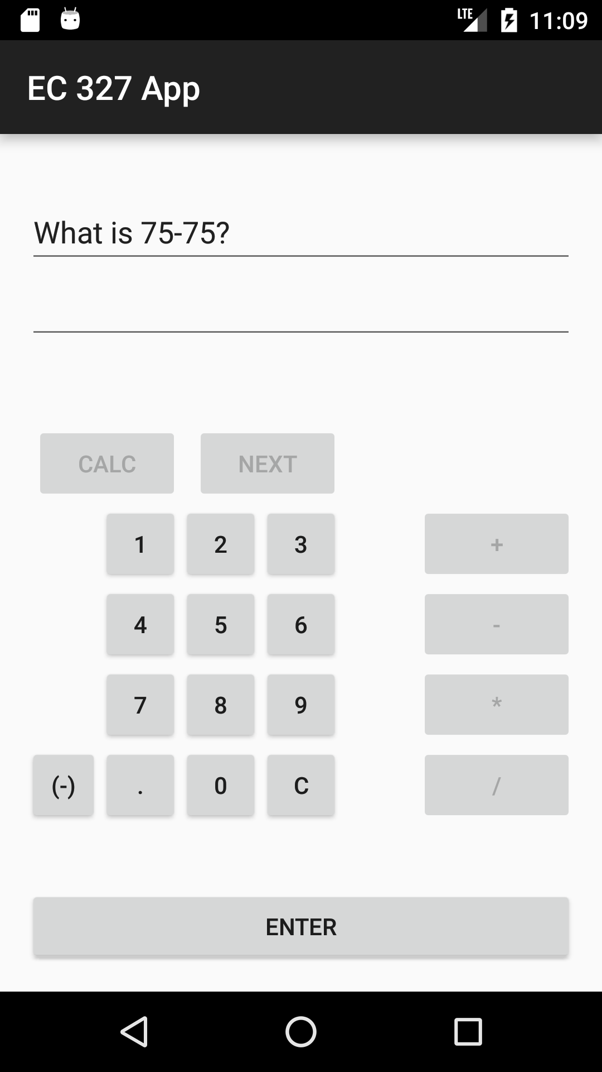
After the user clicks “Next”, one mathematical question will displayed. The user needs to type the answer to that question, and click “Enter”

Slide 7
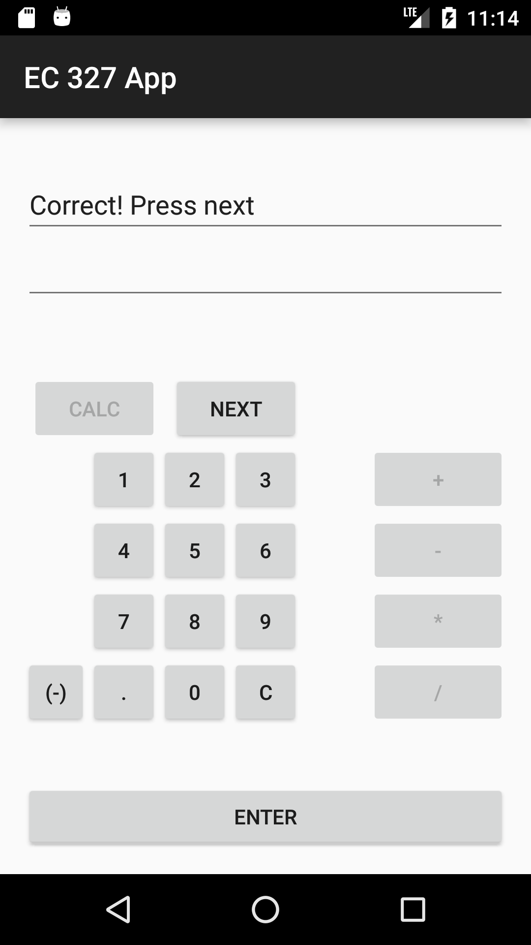
If it’s correct, the program will display “Correct! Press next”

Slide 8
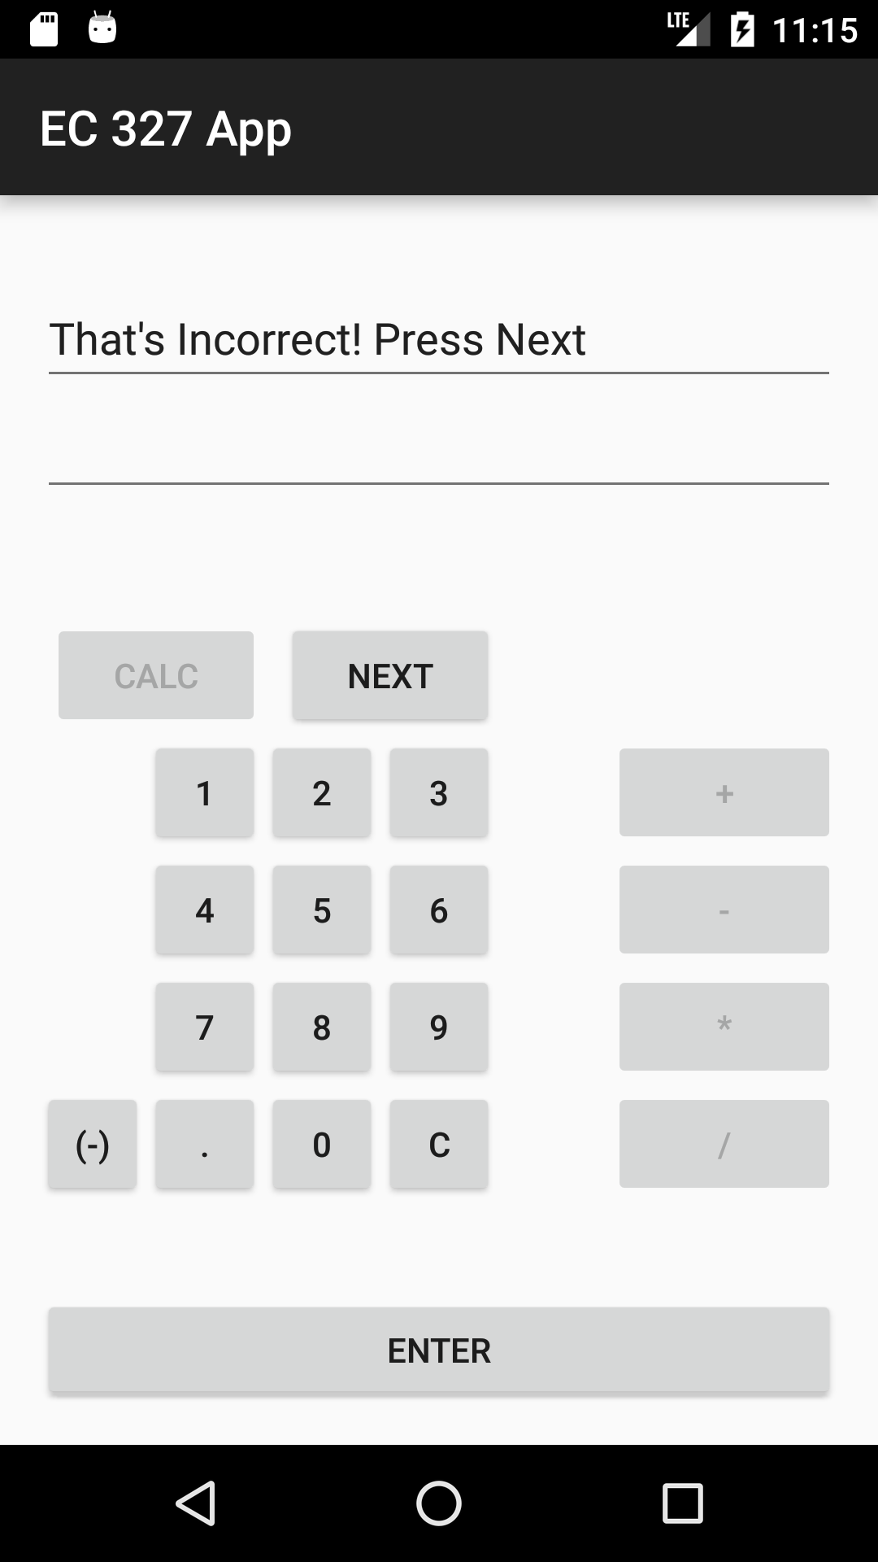
If it’s wrong, the program will display “That’s Incorrect! Press next”

Slide 9
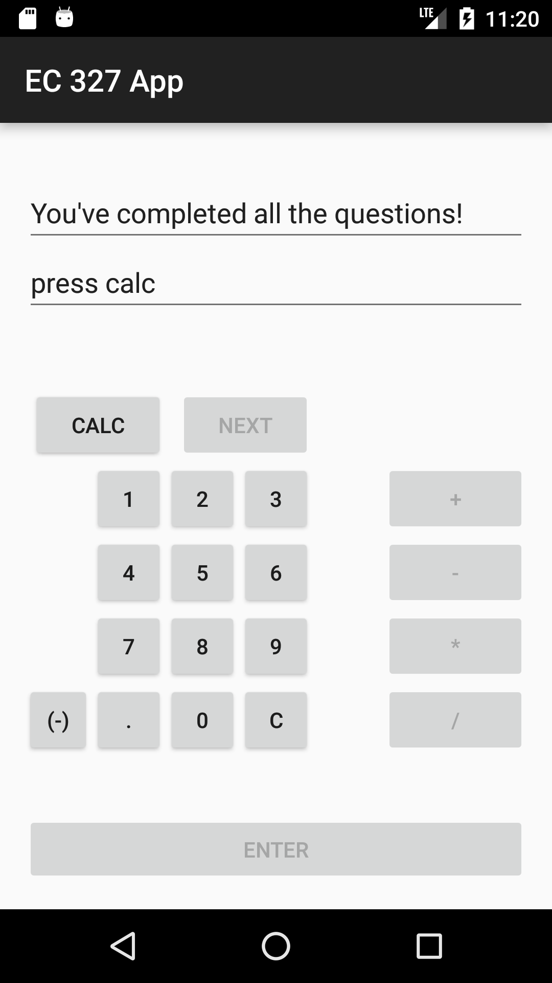
There will be four random questions in total, all of which are add/subtract questions. After the user answers all questions, the program will display “You have completed all the questions, press calc”

Slide 10
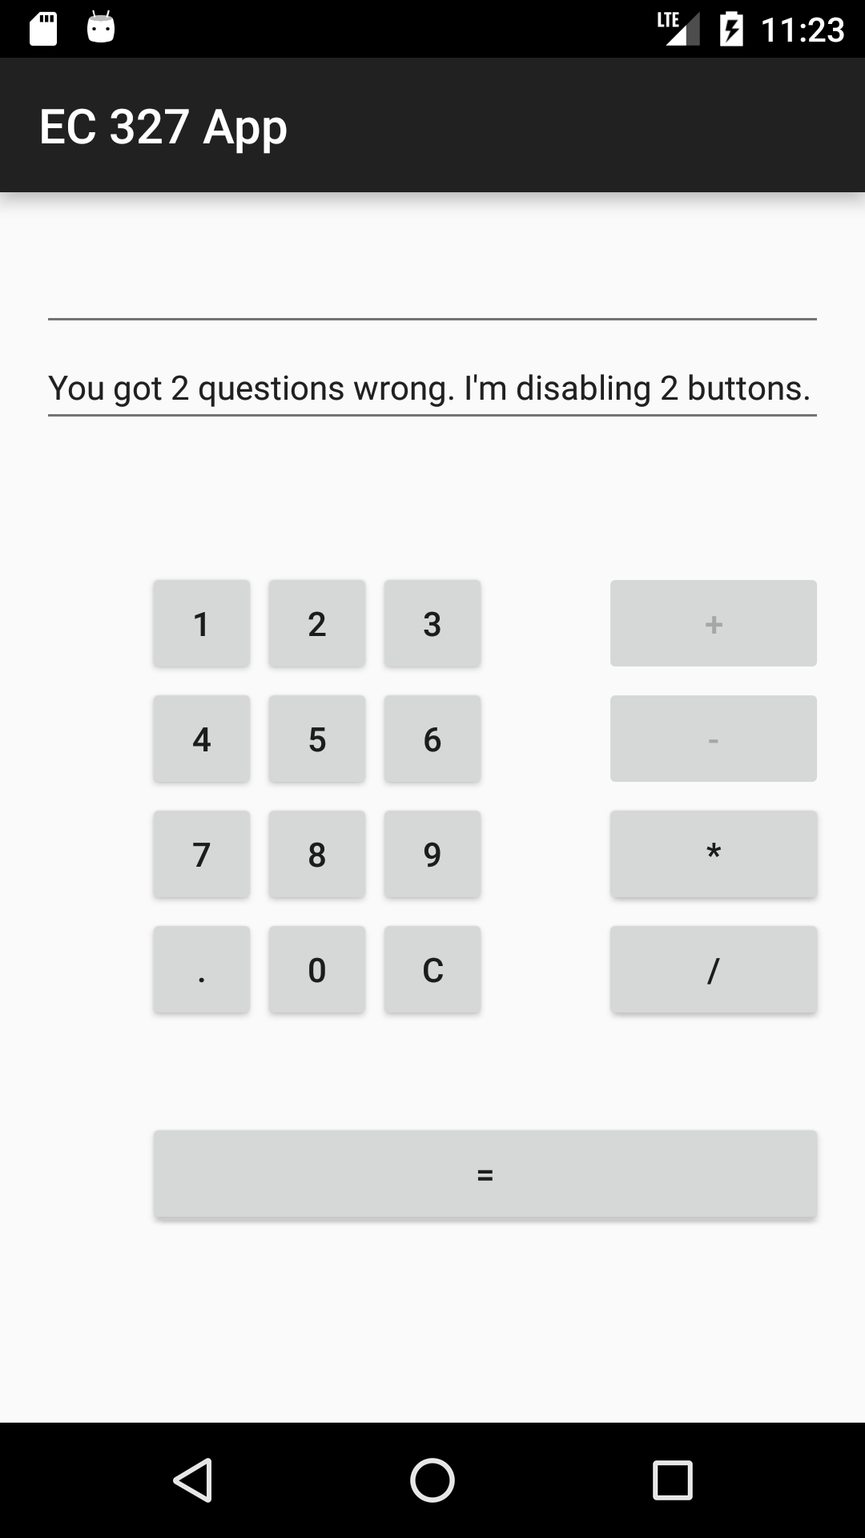
The program will decide how many buttons are disabled based on the user’s the amount of questions answered correctly on the prior screen.
For example, if the user got 2 questions wrong, “+” and “-" will be disabled. But the user could still use “*” and “/.
Furthermore, if the user got one question wrong then the user has access to the everything besides the “+” button etc.

Slide 11
Thank you

